Slide 1
Binomial Queue

Slide 2

Binomial Queues
☞ Structure:
A binomial queue is not a heap-ordered tree, but rather a collection of heap-ordered trees, known as a forest. Each heap-ordered tree is a binomial tree.
A binomial tree of height 0 is a one-node tree.
A binomial tree, B_{k}, of height k is formed by attaching a binomial tree, B_{k – 1}, to the root of another binomial tree, B_{k – 1}.
B₀
B₁
B₂
B₃
Observation : B_{k} consists of a root with children, which are . B_{k} has exactly nodes. The number of nodes at depth d is .
k
B₀, B₁, …, B_{k – 1}
2^{k}
k
d

Slide 3
Binomial Queues
【Example】Represent a priority queue of size 13 by a collection of binomial trees.
Solution:
13 = 2⁰ + 0×2¹ + 2² + 2³ = 1101₂
B₀
B₁
B₂
B₃
13
23
12
51
24
21
24
14
65
65
26
16
18

Slide 4
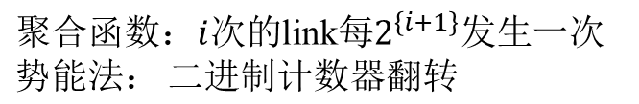
Binomial Queues
☞ Operations:
 FindMin:
 Merge:
最小的放根部
H₁
12
16
21
24
18
1 1 0 ₂ = 6
+ 1 1 1 ₂ = 7
65
H₂
23
14
13
51
24
26
c
c
65
H₁
1
1
0
1
12
14
13
21
24
23
26
16
65
51
24
18
T_{p} = O( )
65
log N

Slide 5
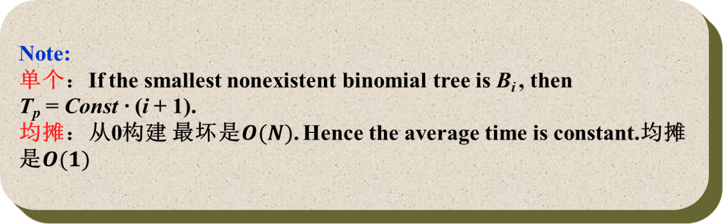
Binomial Queues
 Insert: a special case for merging.
【Example】Insert 1, 2, 3, 4, 5, 6, 7 into an initially empty queue.
1
1
5
3
7
5
2
3
2
6
4
4

Slide 6
 DeleteMin ( H ):
Binomial Queues
H
12
14
13
21
24
23
26
16
65
51
24
18
65
Step 1: FindMin in B_{k}
/* O(log N) */
H’
14
13
26
16
Step 2: Remove B_{k} from H
18
/* O(1) */
H”
23
24
21
Step 3: Remove root from B_{k}
51
24
65
/* O(log N) */
65
Step 4: Merge (H’, H”)
H
14
13
/* O(log N) */
26
16
23
21
24
18
51
24
65
65
FindMin(logN)+RemoveTree(1)+RemoveRoot(logN)+Merge(logN)
=O(logN)

Slide 7
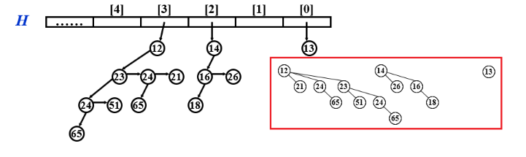
Binomial Queues
☞ Implementation:
Binomial queue = array of binomial trees
Operation
Property
Solution
DeleteMin
Find all the subtrees quickly
Merge
The children are ordered by their sizes
子树的队列是从大到小排列的

Slide 8
Binomial Queues
typedef struct BinNode *Position;
typedef struct Collection *BinQueue;
typedef struct BinNode *BinTree; /* missing from p.176 */
struct BinNode
{
ElementType Element;
Position LeftChild;
Position NextSibling;
} ;
struct Collection
{
int CurrentSize; /* total number of nodes */
BinTree TheTrees[ MaxTrees ];
} ;

Slide 9
Binomial Queues
BinTree
CombineTrees( BinTree T1, BinTree T2 )
{ /* merge equal-sized T1 and T2 */
if ( T1->Element > T2->Element )
/* attach the larger one to the smaller one */
return CombineTrees( T2, T1 ); 要让小的当新头
/* insert T2 to the front of the children list of T1 */
T2->NextSibling = T1->LeftChild;
T1->LeftChild = T2;
return T1;
}
T_{p} = O( 1 )
T1
T2
12
14
24
21
16
26
65
18

Slide 10
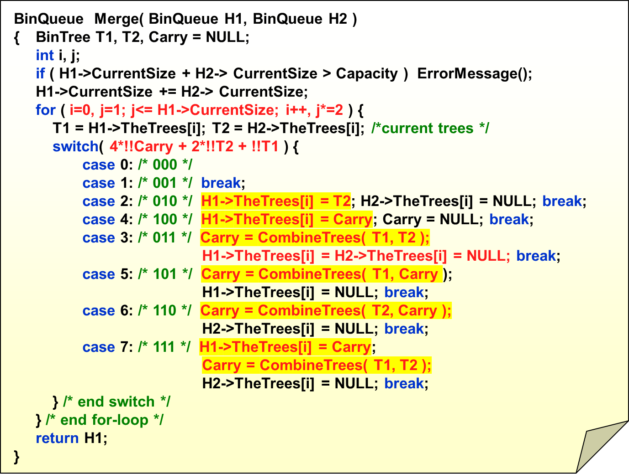
Binomial Queues
/* assign each digit to a tree */
Carry
T2
T1
Notes:
被第一个H1赋值的置为NULL, 出前两个情况无脑后面不用管Carry

Slide 11
Binomial Queues
ElementType DeleteMin( BinQueue H )
{ BinQueue DeletedQueue;
Position DeletedTree, OldRoot;
ElementType MinItem = Infinity; /* the minimum item to be returned */
int i, j, MinTree; /* MinTree is the index of the tree with the minimum item */
if ( IsEmpty( H ) ) { PrintErrorMessage(); return –Infinity; }
for ( i = 0; i < MaxTrees; i++) { /* Step 1: find the minimum item */
if( H->TheTrees[i] && H->TheTrees[i]->Element < MinItem ) {
MinItem = H->TheTrees[i]->Element; MinTree = i; } /* end if */
} /* end for-i-loop */
DeletedTree = H->TheTrees[ MinTree ];
H->TheTrees[ MinTree ] = NULL; /* Step 2: remove the MinTree from H => H’ */
OldRoot = DeletedTree; /* Step 3.1: remove the root */
DeletedTree = DeletedTree->LeftChild; free(OldRoot);
DeletedQueue = Initialize(); /* Step 3.2: create H” */
DeletedQueue->CurrentSize = ( 1<<MinTree ) – 1; /* 2^{MinTree} – 1 */
for ( j = MinTree – 1; j >= 0; j – – ) {
DeletedQueue->TheTrees[j] = DeletedTree;
DeletedTree = DeletedTree->NextSibling;
DeletedQueue->TheTrees[j]->NextSibling = NULL;
} /* end for-j-loop */
H->CurrentSize – = DeletedQueue->CurrentSize + 1;
H = Merge( H, DeletedQueue ); /* Step 4: merge H’ and H” */
return MinItem;
}

Slide 12
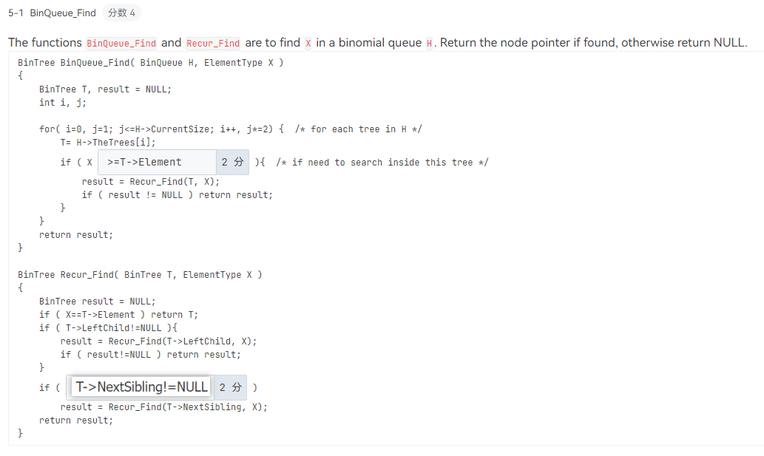

Slide 13


Binomial Queues
【Claim】A binomial queue of N elements can be built by N successive insertions in O(N) time.
Proof 1 (Aggregate):
建立索引
+1
B₀ /*step = 1 */
Total steps =
N
The worst case time for each insertion is
?
+0
B₁ /*step = 1, link = 1 */
Total links =
合并
+1
B₁ B₀ /*step = 1*/
O( log N )
–1
B₂ /*step = 1, link = 2 */
+1
B₂ B₀ /*step = 1*/
B₂ B₁ /*step = 1, link = 1*/
Expensive
insertions remove
trees, while cheap ones
create trees.
B₂ B₁ B₀ /*step = 1*/
–2
B₃ /*step = 1, link = 3*/
B₃ B₀ /*step = 1*/
… … …

Slide 14


Binomial Queues
Proof 2:
An insertion that costs c units results in a net increase of 2 – c trees in the forest. 越贵的操作产生的树的个数就越少
C_{i} ::= cost of the ith insertion
Φ_{i} ::= number of trees after the ith insertion (Φ₀ = 0)
C_{i} + (Φ_{i} – Φ_{i-1}) = 2 for all i = 1, 2, …, N
Add all these equations up
T_{worst} = O(log N), but T_{amortized} = 2

